Slide 1

A Platform Value Model
for IDPs
Ajay Chankramath
Head, Platform Engineering
Sridhar Kotagiri
Platform Product Management Principal
Thoughtworks North America

Slide 2


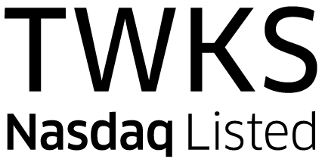
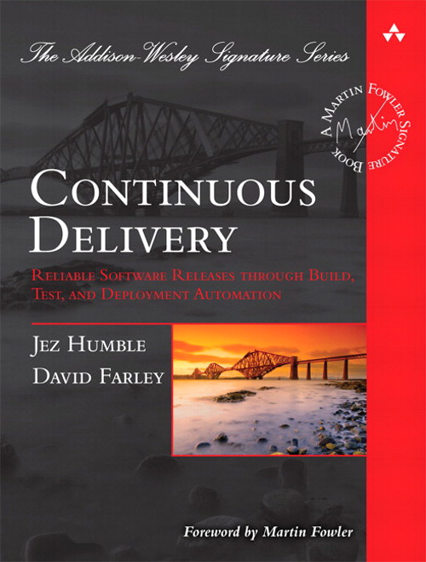








Technology excellence then, now and next
Over the past 30+ years, Thoughtworks has a reputation of being on the forefront, defining the principles used by the most advanced organizations.
1st edition of Technology Radar
2010
Thoughtworks
Incorporated
1993
Thoughtworks lists
on NASDAQ
2021
Data Mesh book, deliver data driven value at scale
2021
ThoughtMobile
Hits the streets
1996
Continuous Delivery book, changes how software is delivered to production
3,000+
Thoughtworkers
2014
Named a leader in The Forrester Wave™: Modern Digital Development Services
2022
7,000+
Thoughtworkers
2019
12,500+
Thoughtworkers
2022
1st office outside U.S. for distributed agile
2000
Thoughtworks University
Run 60+ times since
2005
Microservices paper and book, revolutionizes distributed computing
Apax Partners acquires Thoughtworks
2017
Thoughtworks acquires Connected in Canada and Handmade in Brazil
2022
First continuous integration server
2001
Chief Scientist, Martin Fowler co-authors Agile Manifesto
500+
Thoughtworkers
2004
2001
AnitaB.org names Thoughtworks Top Company for Women Technologists
2016 - 2018 and 2020
Created Selenium, setting a new industry standard for cross platform cross browser web-app functional testing

Slide 3
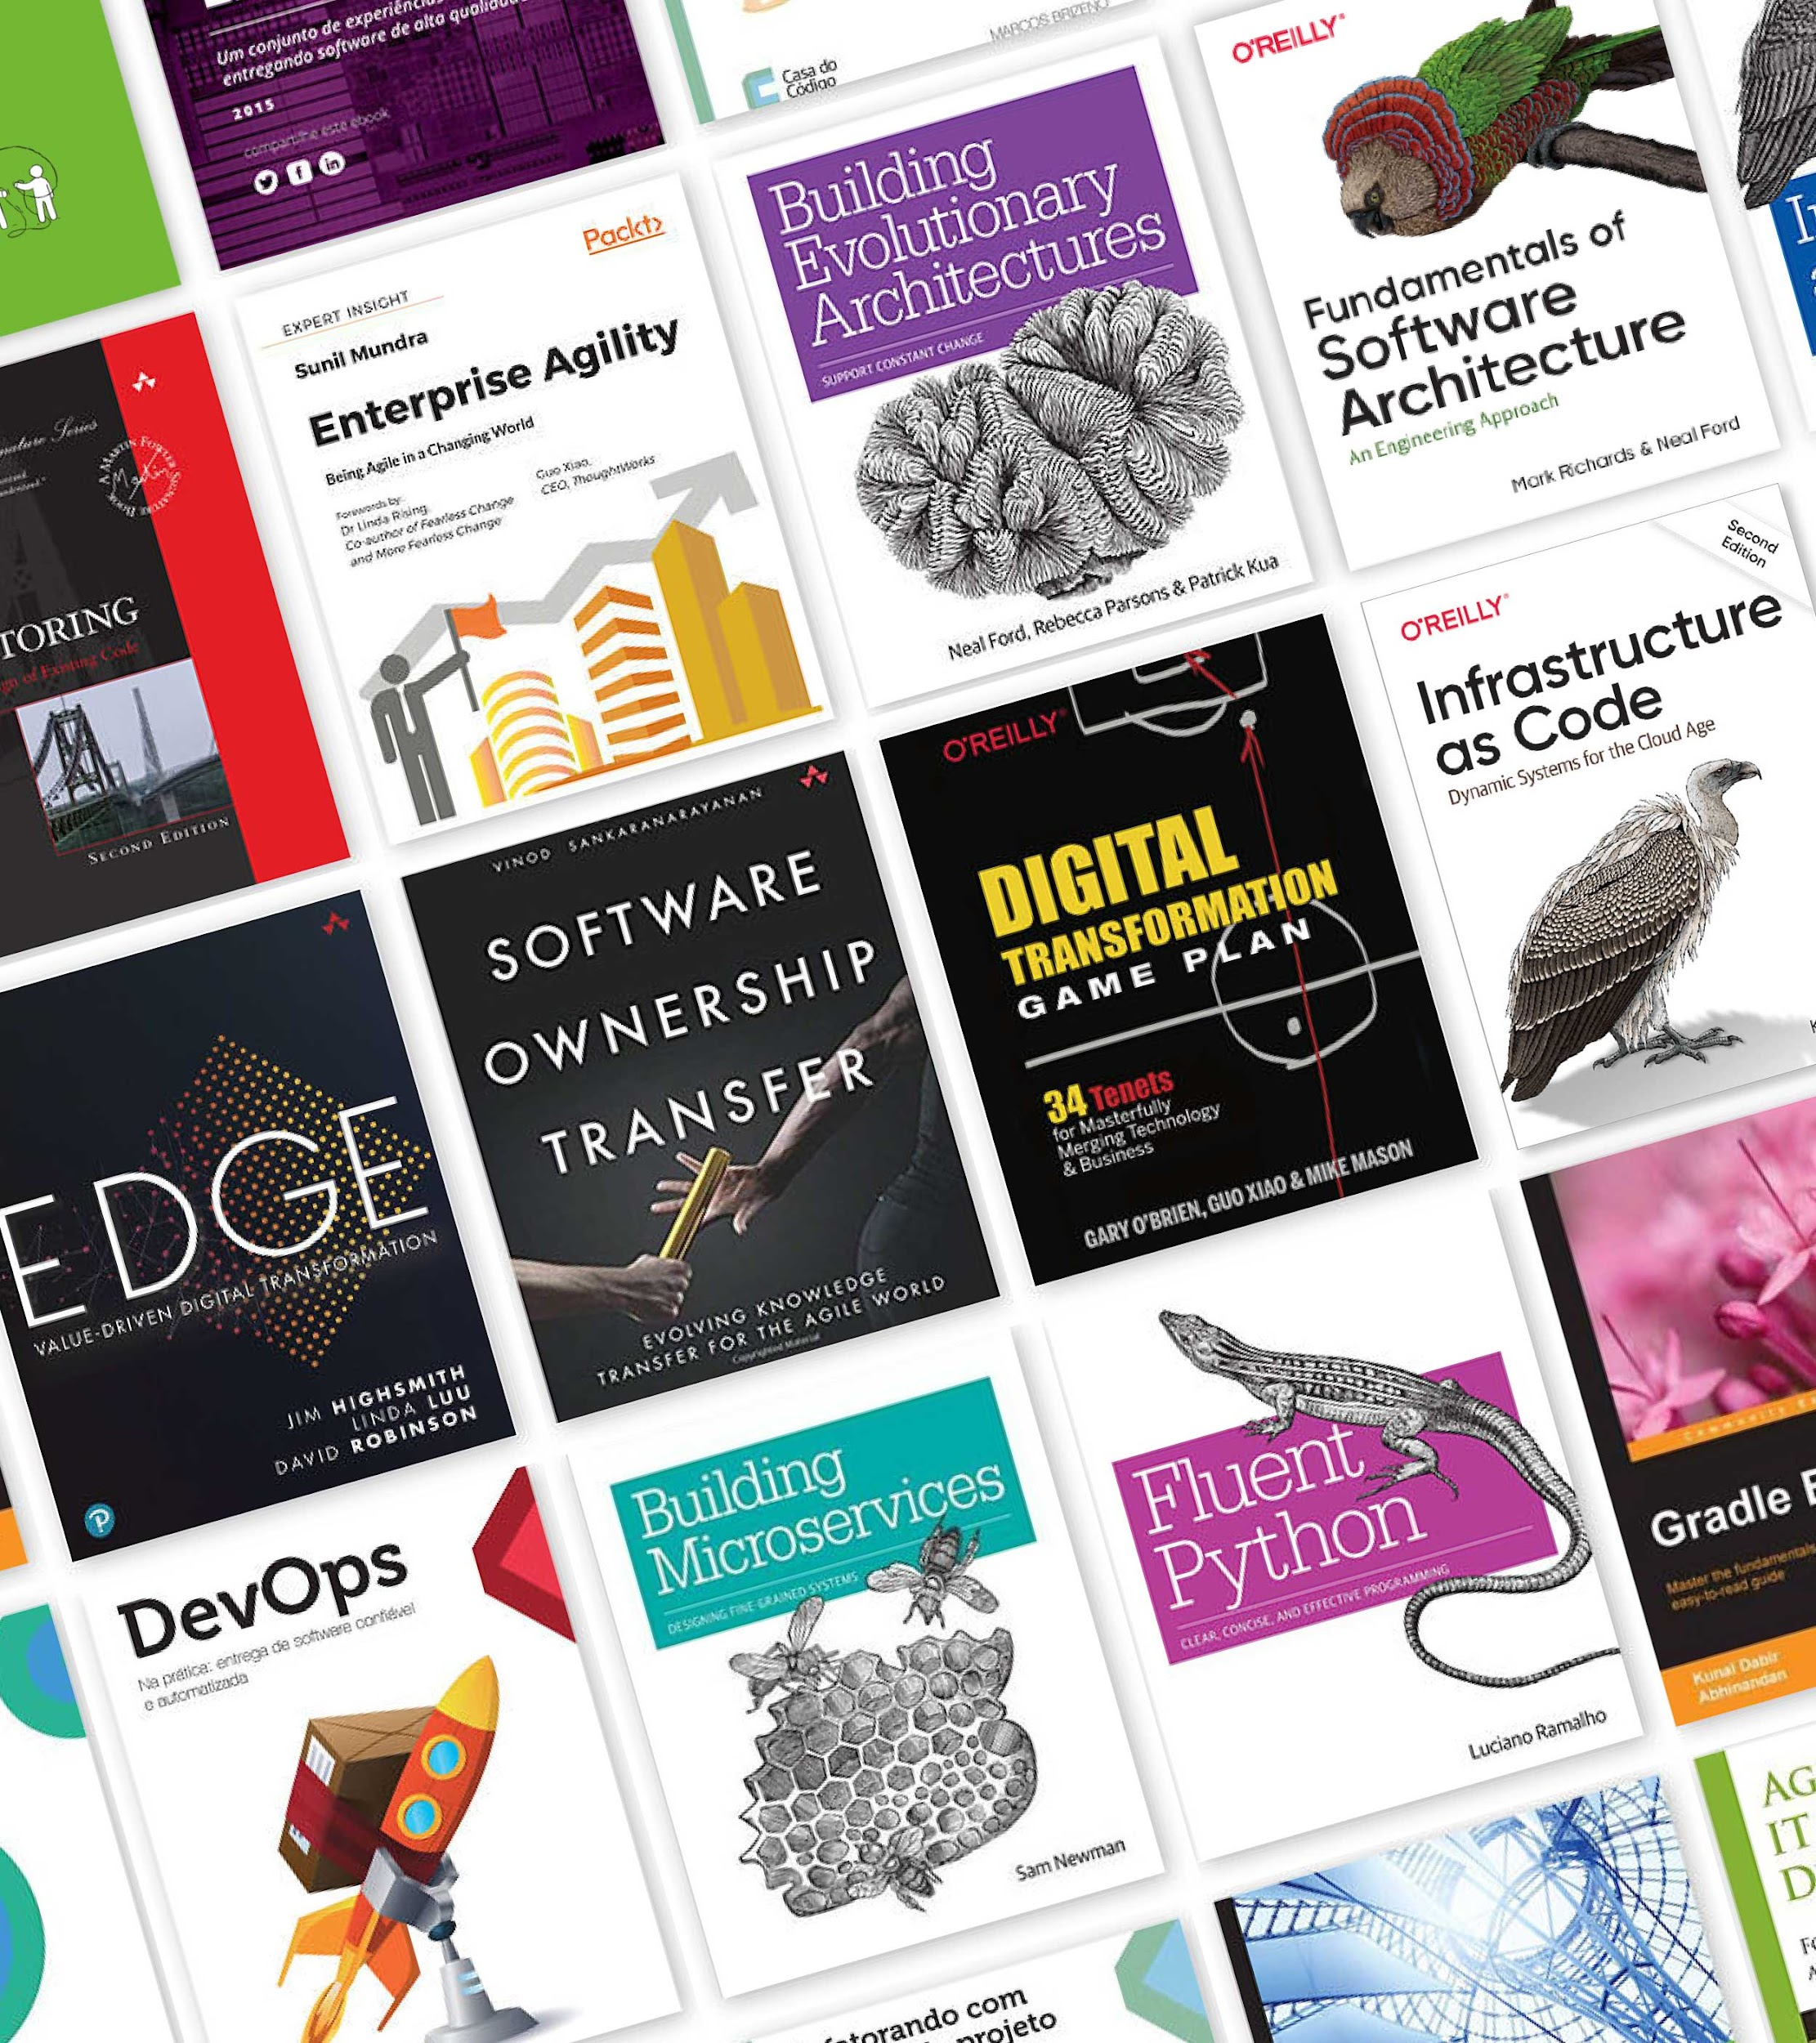



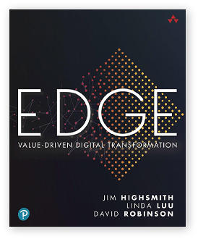
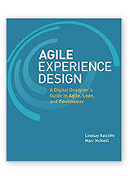
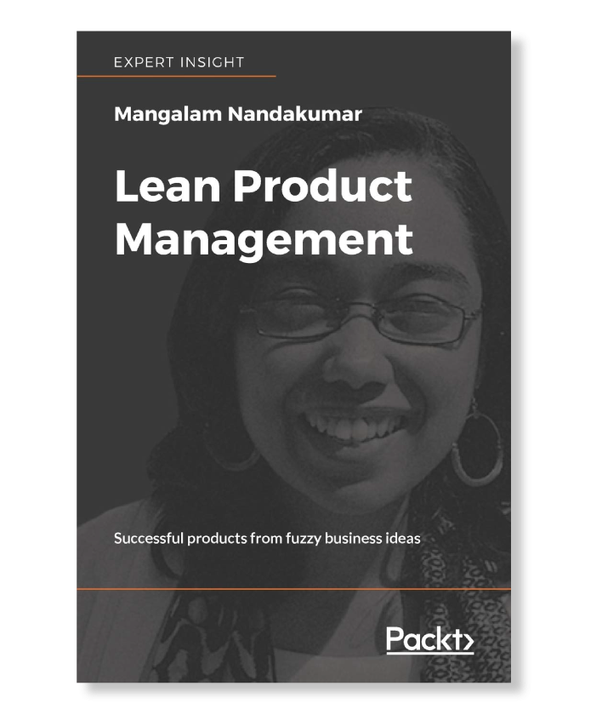

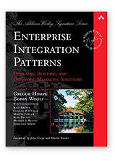
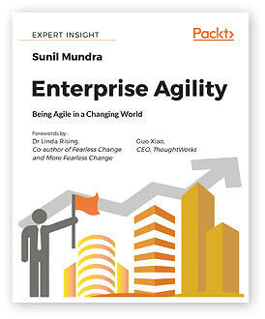

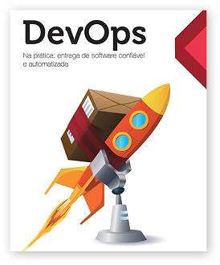

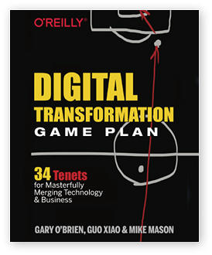
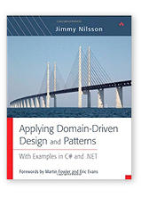
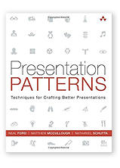
Spreading thought leadership
100+
books written
Application Architecture & Legacy modernization
Digital Products
API Strategy &
Integration patterns
Perspectives A publication for digital leaders Learn more
Technology Radar An opinionated guide
to technology frontiers Learn more
Digital Fluency Model Discover your digital fluency Learn more
Decoder The A-Z guide to tech for business executives Learn more
Looking Glass The trends your business should focus on today and in the future Learn more
Continuous Delivery
Omnichannel Platforms
Notes:
We pride ourselves on also giving back to the community through our thought leadership, we’ve written 100+ books on everything from value-driven digital transformation and lean product management to DevOps, and test driven development.

Slide 4
What made us think of Platform Value?
MULTIPLE ENGINEERING TEAMS
REUSABLE INTERNAL CAPABILITIES
FEATURE CONGESTION WITH PRIORITIZATION & ROI
Notes:
Your internal teams have similar requirements for platform capabilities
Examples
Automated Infrastructure Provisioning
Generate application scaffolding for faster startup
Observe applications to improve performance and reliability
However there is obvious congestion when it comes to prioritizing the specific capabilities that should be built
This calls for a thoughtful and objective approach to deciding what should be built when
Platform Value Model and the ensuing metrics provide an easy to way to make the determination on
Whether a capability should be abstracted out as a platform features
How would that capability buildout be prioritized compared to the rest of the features

Slide 5
IDP is an “Enabler”
Experience
Experience
Experience
Business capabilities platform
Business capabilities platform
Data Platform
Internal Developer Platform
(Includes the Infrastructure Platforms)
Notes:
Platform that is built on top of engineering capabilities focusing on core products & services that can be composed into experiences.
A platform of self-service APIs, tools, services, knowledge and support that enable delivery of business features at a higher pace, with reduced friction

Slide 6
How do we build IDPs?
Thin slicing approach based on the context & requirements
Developer Plane
Version Control, Infrastructure as Code , Dev Tools, Paved Road, Dev Backends
Compliance & Governance Plane
Pipelines , Lightweight governance, FinOps compliance, Compliance @ POC
Platform Product Management
Team Topologies, Technical Product Management, Value Modeling, Planning & Productivity
Characteristics
Self-Serve, Onboarding enablers, Operational backbone, on-demand documentation, AI integrations
Delivery Plane
Containers, Kubernetes, Platform orchestration
Observability & Visibility Plane
Observability, Integrations, Sustainability , Work Allocation, Code Health Surveys
Security Plane
IAM, Secret and Encryption Management, SIEM

Slide 7
Stakeholders Not Aligned
Agree, we should build it !!
Where is the impact??
Teams are able to function without!!
Need a bigger team!!
Need it fast!!
Spending too much money!!
Business Stakeholder
Tech Stakeholder
Should prioritize business features instead!!
More teams should use it!!

Slide 8
Measure Value for IDPs
Gain visibility into ROI and value delivery timeline
Prioritize competing investments based on value rather than gut feel
Quantify the impact on customer and the business goals
Align stakeholders
Notes:
IDPs are complex, technical platforms. Require significant investment - Ensure the pay off
ROI and timeline - manage expectation, make informed decisions
Prioritize Competing Investments - objectively compare different initiatives and allocate resources to ensure the most significant impact
Impact on Customers and the Organization - positive difference for our end-users and aligning with our strategic objectives
Align stakeholders: demonstrating tangible benefits, becomes easier to gain buy-in from executives, investors, and other key stakeholders.

Slide 9
Value Challenge with IDPs
Indirect Impact to Business Outcomes → 2nd class status | Value is not Static → Unclear on investment needed and the urgency
Hard to Quantify and Articulate → Enabler Platforms | Need upfront investment → Concerns with upfront investment
Challenge
Notes:
Value may not be obvious as customer facing products
ecomm metric - Avg. cart value
Platforms evolve over time, value depends on engineering team enablement level and org culture and buy in
Benefits often manifest indirectly through enhanced productivity, reduced time to market, and improved developer experience. Quantifying them can be challenging
Need upfront investment before running production workloads, can be barrier to securing support and resources.

Slide 10
Platform Value Cycle
Measure Value
Platform Value Metrics
Assess how well the platform is delivering on its objectives
Build the right thing
Define Value
Platform Value Model
Model cost, value over a timeline for decision making
Build the thing right
Notes:
Measuring value 2 step process, first define, build and then measure to ensure it is indeed delivering the value intended, repeat for incremental development
1st step in the cycle is to define value. A well-structured Platform Value Model can help articulate the key cost, savings and the timeline involved
While Value model helps decide what to build, Platform Value Metrics help track the performance quantifiable data points to help assess against objectives
This iterative approach ensures that the platform remains a strategic asset for our organization.

Slide 11
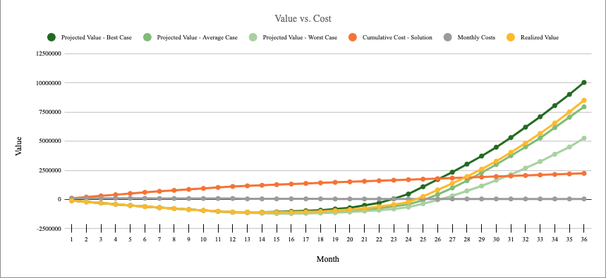
Platform Value Model
Models costs and value over a timeline
Model that supports various cost factors and scenarios, extensible depending on specific needs of a given technical platform product investment.
Assesses optimistic and pessimistic scenarios
Accommodates change during execution
Ability to model Realized vs. Projected value
Accommodates varying success metrics
Structure that can be extended for any other technology investments

Slide 12

Who is this for?
Drive Value Based Prioritization
Understand why and define how
Execute solution based on priority
Articulate, Forecast & Track
Present the objective value proposition
Product Managers
Product Owners
Business Leadership
Build
Measure
Learn
Engineering Leadership
Making Investments

Slide 13
How to Use?
Quantifying value for technical platform capabilities is not always straightforward, value modeling provides a solid starting point
Extend based on the use case
During prioritization - build one for each of the platform capabilities
Make right assumptions
Extend and customize
Make it working Model
© 2022 Thoughtworks | Confidential
Notes:
During prioritization - With competing priorities build this model for each technical product capability for value driven prioritization
Make right assumptions - Costs used in this model are not readily available, make right assumptions based on experience and data available
Extend and customize - This model is not a one size fits all, extend/update the measurement criteria, costs and the timeline based on the use case and needs
Make it working Model - Decisions change and the reality may look different, keep the model upto date to reflect the reality

Slide 14
Value Modeling - 3 Step Process
1
2
3
Develop Cost Baselines (Team,Infra, etc..)
Value Summary Graphs
Calculate Build Cost
Calculate Savings / Workload
Value Projections
Platform Architecture
Articulate with business outcomes
Value timeline
Setup
Cost Outlay
Simulate ROI
Outcomes

Slide 15
Value Modeling Demo Use Case
Business Context: ABC corporation considering adopting microservice architecture to support their exponential growth
Problem Statement: Diverse implementations across product engineering teams. Some teams own their cloud infrastructure and others rely on OPs team
Opportunity: Building a container orchestration platform to help reduce the cognitive load abstract away the complexity
Solution: Platform architecture chose AKS to be the base solution for the platform
Investment range: $1 to $3M
Value expected: $5 to $10M
Pre-requisites:
Proposed Team size required
Infra and licencing needs
Measurement criteria
Timeline for realizing the value
Required cost data
© 2022 Thoughtworks | Confidential

Slide 16
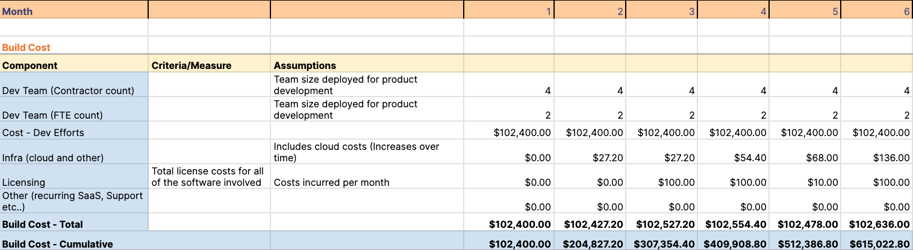
Step # 1 - Calculate Build Cost
© 2022 Thoughtworks | Confidential

Slide 17
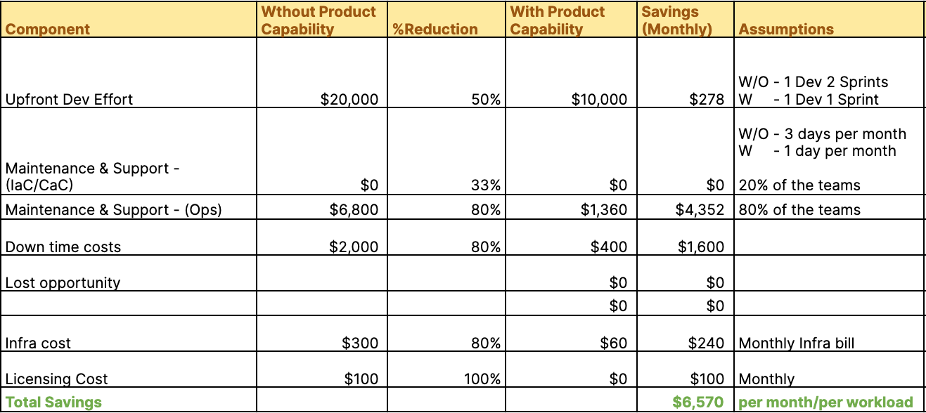
Step # 2 - Calculate Savings Per Workload
© 2022 Thoughtworks | Confidential

Slide 18
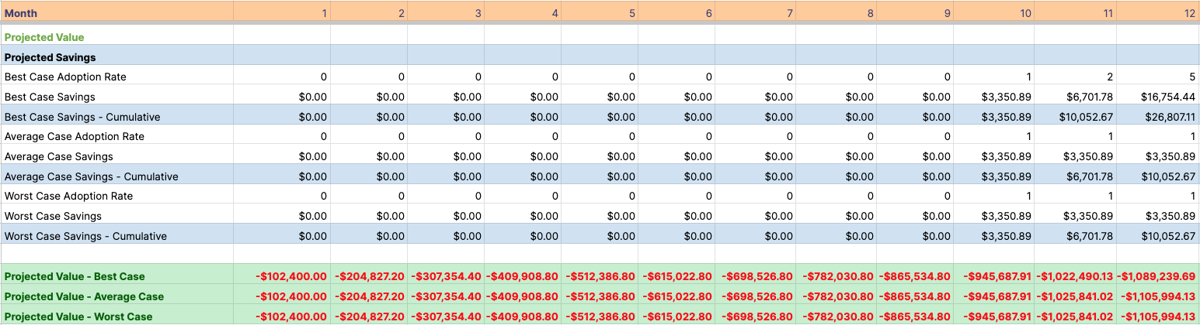
Step # 3 - Projected Value - Year 1
Assumptions:
Starts with PILOT phase and ramp up with Early adaptors and General Availability. Given the capability will mature over time, value will be incrementally higher as the capability matures. Used 50% for Year 1, 75% Year 2 and 100% for Year 3
Criteria/Measure:
Number of workloads deployed
Varies based on the product,
Ex. criteria:
Number of workloads/services
Percentage of adoption
Number of pipelines/dashboards
© 2022 Thoughtworks | Confidential

Slide 19
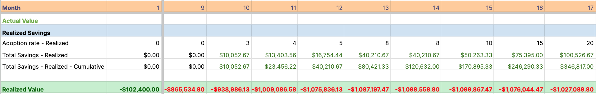
Step # 3 - Track Realized Value

Slide 20
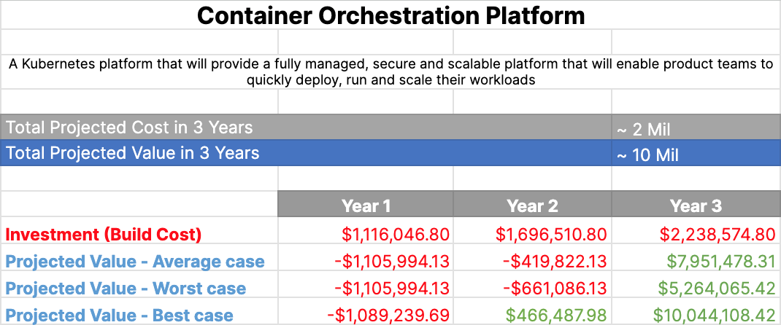
Outcome - Value Summary
© 2022 Thoughtworks | Confidential

Slide 21
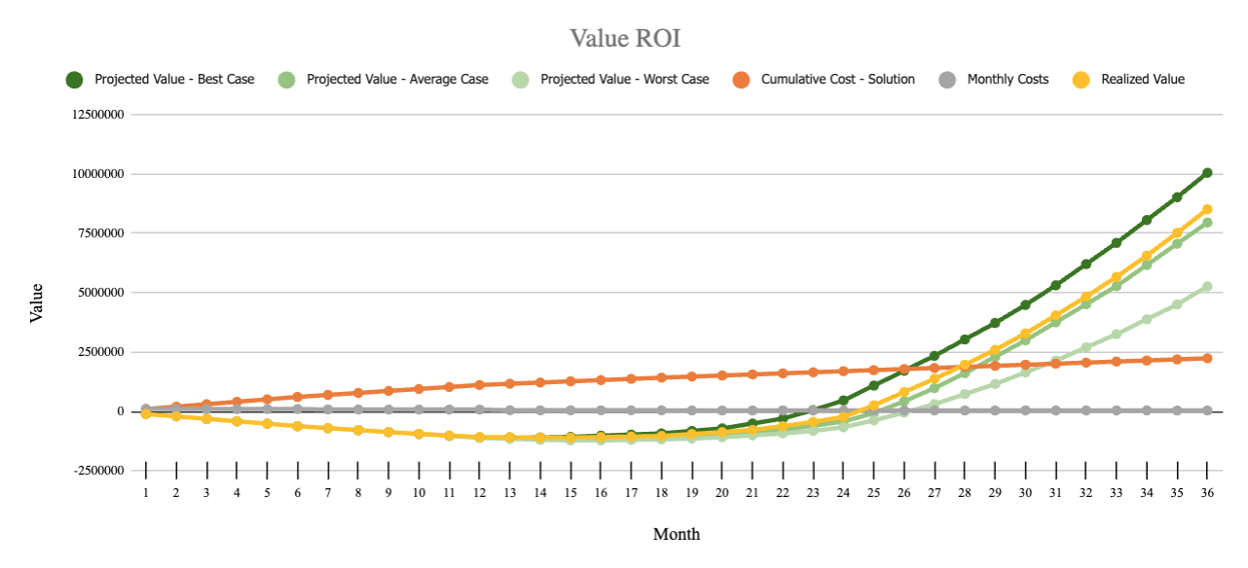
Outcome - Value Summary
S
© 2022 Thoughtworks | Confidential

Slide 22
Connecting to business outcomes
S
Revenue
Profitability
Increases
Enables
Customer Experience
Increases
Increases
Improves
Improves
Improves
Improves
Improves
Improves
DX
Time to Value
Quality & Reliability
Predict, Prevent & Recover Fast
Innovation
Cost Efficiency
Improves
Contributes to
Improves
Contributes to
Improves
Improves
Improves
Improves
Contributes to
Enables
Improves
Improves
Faster Application Startup
Reduced Cognitive Load
Faster Pipeline Development
Observe Applications and Infra
Security
Monitor & Alert
Resilience & Availability
Contributes to
Enables
Assures
Improves
Contributes to
Enables
Contributes to
Enables
Enhances
Enhances
Assures
Assures
CI/CD
Observability
Container Orchestration
Secrets Management
Certificate Management
Paved Paths
Platform Capability
Technical Outcome
Business Driver
Business Outcome

Slide 23
Connecting to business outcomes
S
Platform Capability
Technical Outcome
Business Driver
Business Outcome
Customer Experience
Revenue
Profitability
Enables / Contributes to /
Improves
Developer Experience
Time to Value
Quality & Reliability
Predict, Prevent & Recover Fast
Innovation
Cost Efficiency
Enables / Contributes to /
Improves
Faster Application Startup
Reduced Cognitive Load
Faster Pipeline Development
Observe Applications and Infra
Security
Monitor & Alert
Resilience & Availability
Enables / Contributes to /
Improves
CI/CD
Observability
Container Orchestration
Secrets Management
Certificate Management
Paved Paths

Slide 24
Connecting to business outcomes
S
Faster Application Startup
Reduced Cognitive Load
Faster Pipeline Development
Observe Applications and Infra
Security
Monitor & Alert
Resilience & Availability
Enables / Contributes to /
Improves
CI/CD
Observability
Container Orchestration
Secrets Management
Certificate Management
Paved Paths
Platform Capability
Technical Outcome

Slide 25
Connecting to business outcomes
S
Developer Experience
Time to Value
Quality & Reliability
Predict, Prevent & Recover Fast
Innovation
Cost Efficiency
Enables / Contributes to /
Improves
Faster Application Startup
Reduced Cognitive Load
Faster Pipeline Development
Observe Applications and Infra
Security
Monitor & Alert
Resilience & Availability
Technical Outcome
Business Driver

Slide 26
Connecting to business outcomes
S
Customer Experience
Revenue
Profitability
Enables / Contributes to /
Improves
Developer Experience
Time to Value
Quality & Reliability
Predict, Prevent & Recover Fast
Innovation
Cost Efficiency
Business Driver
Business Outcome

Slide 27
Platform Value Metrics (PVM)
Platform Value Metrics are key metrics emanating from the Platform Value Model we propose:
Improved Cost Efficiency
Drive growth with faster experimentation
Improved Developer Experience
1
2
3
Value to Cost Ratio
(VCR)
Projected Value / Cost
Sensible Default 2
Target 10 / 3 years
Innovation Adoption Rate
(IAR)
YoY Growth= (Adoption This Year - Adoption Last Year) /Adoption Last Year ​ ×100
Sensible Default 10%
Target 30% / 3 years
Developer Toil Ratio
(DTR)
Total Time on Toil / Total Time on Feature Development
Sensible Default < 30%
Target <10%
Notes:
Organizations primarily drive towards one of the following goals
Become nimble by driving cost optimization - VCR
Drive growth by driving with innovation and new feature delivery - IAR
Drive better developer effectiveness - DTR
High Toil
Causes
manual,
repetitive,
No enduring value
Results
Low morale
burnout
Career stagnation
Attrition

Slide 28
PVM in the context of DORA4 + 1
Lead time for changes
Change Failure Rate
Value to Cost Ratio (VCR)
Deployment Frequency
Lagging
Innovation Adoption Rate (IAR)
MTTR
Developer Toil Ratio (DTR)
Reliability

Slide 29
PVM in the context of Flow Metrics
Request to Prod Time
(Cycle Time)
Leading
Value to Cost Ratio (VCR)
Velocity of completed work items
Innovation Adoption Rate (IAR)
Lead time - WIP
Developer Toil Ratio (DTR)
Efficiency - Distribution in work and waiting stages
Lagging
Distribution - Types of work done at any given time

Slide 30
Additional PVMs
Model Feedback
2022 in a Snapshot
What do we need from you?
Codified Models?
Sensible defaults
Changing Targets
Anomalies
Notes:
Try out the model and metrics in your platform engineering efforts
Provide feedback on what additional metrics you would like to see
Have conversations with your product management and stream-aligned teams to see if this gives a better leading understanding of their platform engineering efforts
Not intended as a replacement for DORA metrics as leading indicators, but to augment and support that as you hone in on platform capabilities
Reach out to us for a copy of the value model

Slide 31

Questions/More Information?
 | ajayc@thoughtworks.com, sridhar.kotagiri@thoughtworks.com
 | @ajchantw, @yeskttr
 | chankramath , yeskotagiri
 | @Ajay Chankramath, @Sridhar Kotagiri
Notes:
1. Understand how this model is applicable to the entire platform capability decision making process
2. Steps to incorporate this model into their devops journey
3. How to extend and customize this model for seamless contextual integration

